Slide 1

Switch Cases

Slide 2
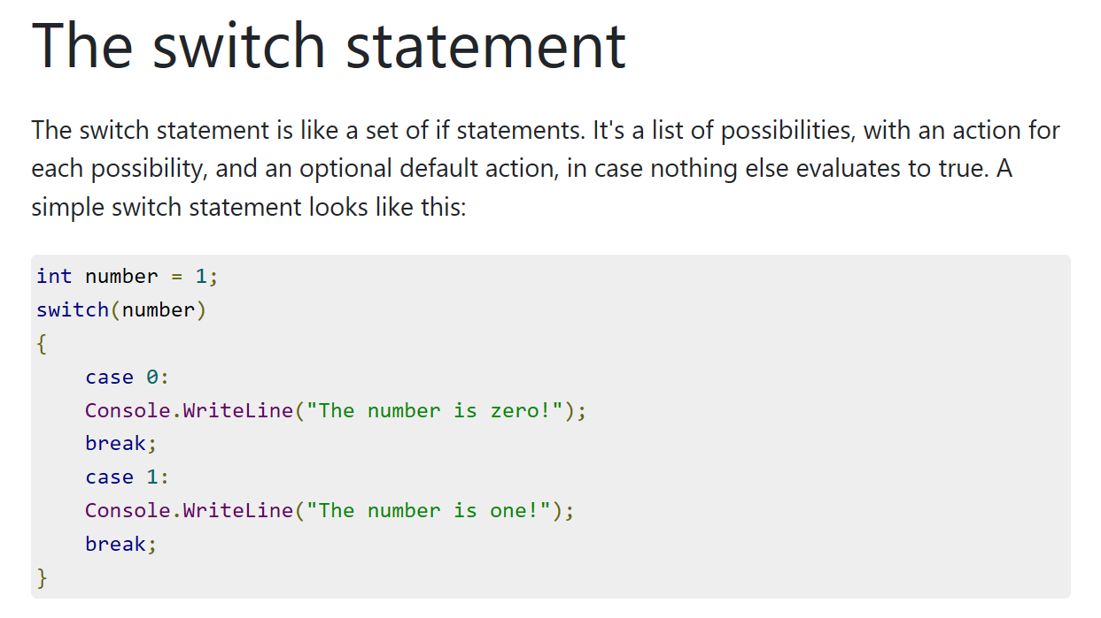

Slide 3
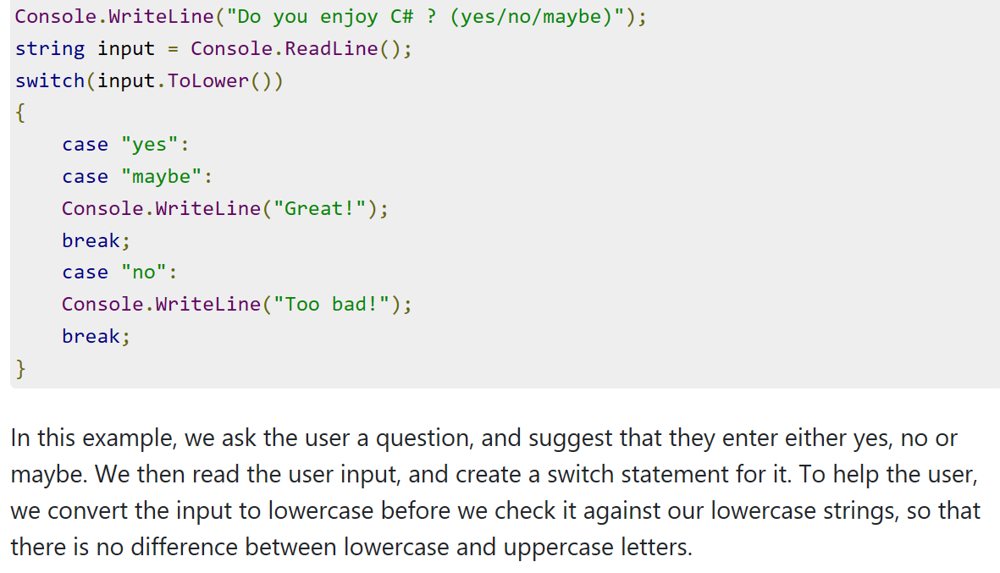

Slide 4
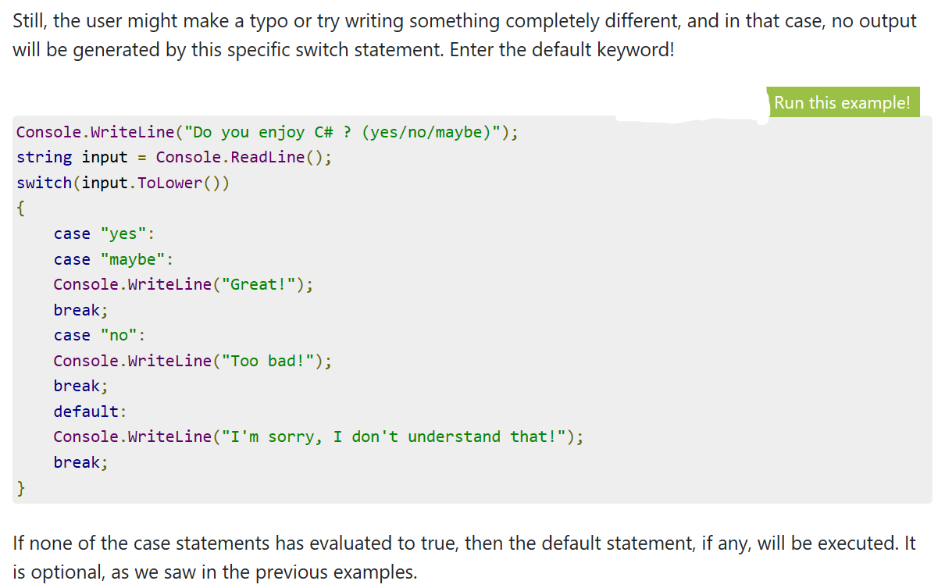

Slide 5

Exercise 1
Write a C# Sharp program to check whether an alphabet is a vowel or consonant. (Use switch cases)

Slide 6
Exercise 2
Write a program in C# Sharp to read any digit (between 1 and 5), and display it in words.

Slide 7
Exercise 3
Write a program in C# Sharp to read any Month Number in integer and display Month name in words. (Apply this for Days of the week)

Slide 8
Exercise 4
Write a program in C# Sharp to read the number of the day in a week, and display it in words. {Hint; be creative (Use any technique you’ve learnt.)}

